Slide 1


AI-POWERED HEALTHCARE ASSISTANT
A RAG-Powered Healthcare Chatbot for Patients and Professionals
Team Members: Lauren Carter, Domenic Guerrero, Sandeep Singh, Kevin Curry, Micah Purdome
Notes:
sandeep

Slide 2

EXECUTIVE SUMMARY
Challenge: The need for quick, evidence-based responses to medical queries for patients, medical students, and healthcare providers.
Solution: A healthcare assistant powered by a Retrieval-Augmented Generation (RAG) pipeline.
Key Features:
Accurate, evidence-based medical answers.
Voice-based interaction for accessibility.
Real-time information retrieval using cutting-edge AI models.
Notes:
dom

Slide 3
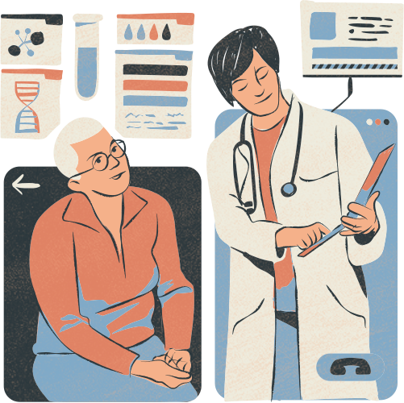
PROJECT GOALS
Provide precise, evidence-based responses to medical questions.
Integrate speech-to-text functionality for accessibility.
Utilize an efficient RAG pipeline with recursive retrieval methods.
Leverage cutting-edge AI technologies like LangChain, Hugging Face, and OpenAI models.
Notes:
dom

Slide 4
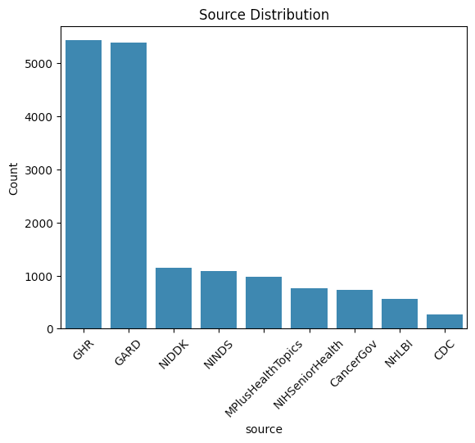
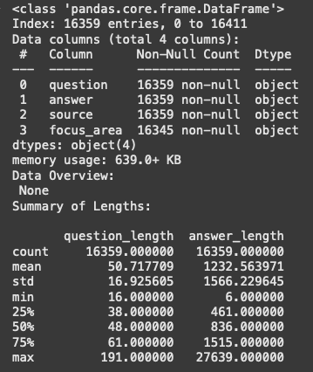
Exploration:
Visuals: Bar chart of data sources (e.g., NIDDK, CDC, Cancer.gov) and their contribution to the dataset.
Text statistics: Number of questions, average question/answer length, and notable patterns (source distribution is global healthcare resources that are all credible)
DATA COLLECTION & PREPROCESSING
Data Source: MedQuAD Medical Question-Answer Dataset (link to Kaggle).
Data Cleaning:
Dropped missing and duplicate rows.
Removed special characters and extraneous text from the "answer" field.
Notes:
micah

Slide 5
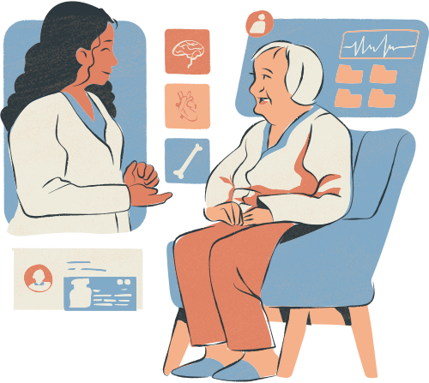
CORE FRAMEWORKS & KEY COMPONENTS OF THE RAG PIPELINE
Core Frameworks:
LangChain: Orchestrates RAG pipeline logic.
OpenAI (Whisper, GPT): Embeddings, voice transcription, and LLM.
Hugging Face Transformers: NLP for question/answer processing.
Chroma: Vector database for fast document retrieval.
Groq LLM: Handles large language model-based responses.
Key Pipeline Components:
Data Loading: CSV file ingestion using LangChain loaders.
Vectorization: Converts documents into searchable vectors.
Retrieval: Top-k context matching with recursive query.
Answer Generation: Generates precise answers using LLM (Groq, OpenAI GPT).
Notes:
micah: add something about why we made certain decisions (ie picking groq and open ai) over others

Slide 6
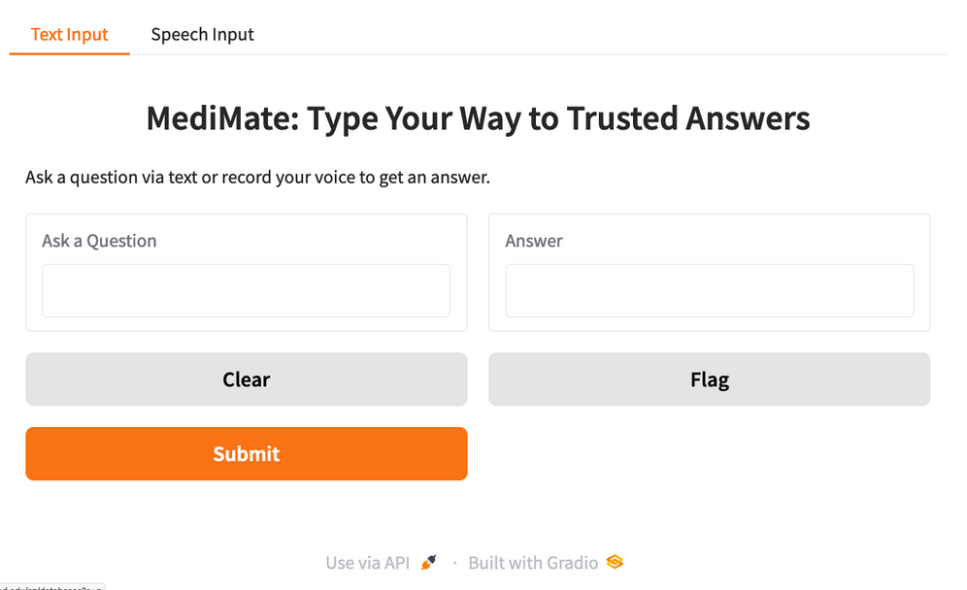
SPEECH-TO-TEXT & USER INTERACTION
Goal: Voice-based queries for users with limited text-input capacity.
Implementation:
Used OpenAI Whisper for real-time voice transcription.
Audio recorded as .wav files, then transcribed with OpenAI API.
User Experience:
Input: Voice query.
Output: Transcribed question + medical answer via RAG system.
Gradio Interface: Two tabs for text and voice input.
Screenshot: Include a snapshot of the interface.
Notes:
kev

Slide 7
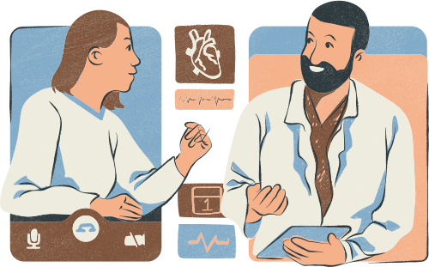
FUTURE DEVELOPMENT
Features to Add:
Mobile app integration
Multilingual support using Hugging Face transformers
Incorporation of more diverse medical datasets for better contextual answers
Research Directions:
Bias mitigation: Ensuring responses are balanced and inclusive
Expansion to other industries (mental health, nutrition, etc.).
Notes:
lauren

Slide 8

RESULTS & PERFORMANCE
Performance Highlights
Detailed, evidence-based answers for healthcare professionals.
Evaluation Results
Precision, Recall, F1-Score: 0.0 (verbose vs. concise mismatch).
ROUGE-1: 0.121, ROUGE-L: 0.115 (context-rich focus).
Response Time <5s: Efficient, real-world ready
Notes:
lauren (w assistance from sandeep for questions)

Slide 9
DEMO TIME!
Notes:
lauren (w assistance from sandeep for questions)

Slide 10

THANK YOU!
Questions?

Slide 11
REFERENCES
Afroz, P. (n.d.). MedQuAD: Medical Question Answer for AI Research [Data set]. Kaggle. https://www.kaggle.com/datasets/pythonafroz/medquad-medical-question-answer-for-ai-research

